Slide 1
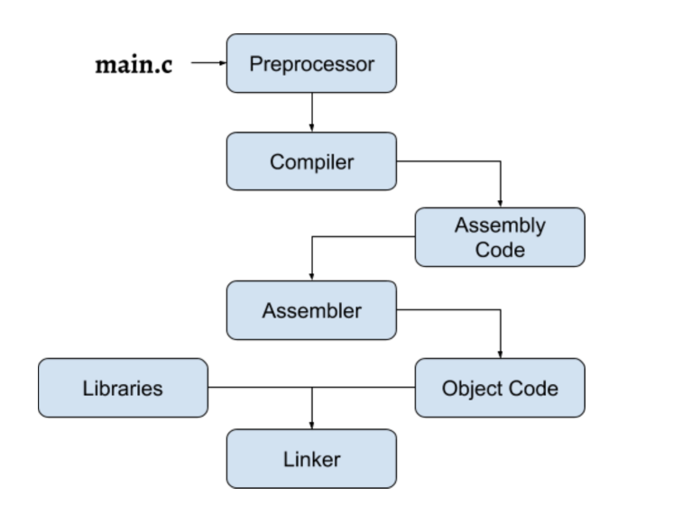
C++ language
Key features:
Compiled language
Multi-paradigm programming language:
Procedural
Object-oriented
Functional
Generic
Modular
Standardized
Language versions (according to standard):
C++98
C++03
C++07
C++11
C++14
C++17
C++20
C++23

Slide 2
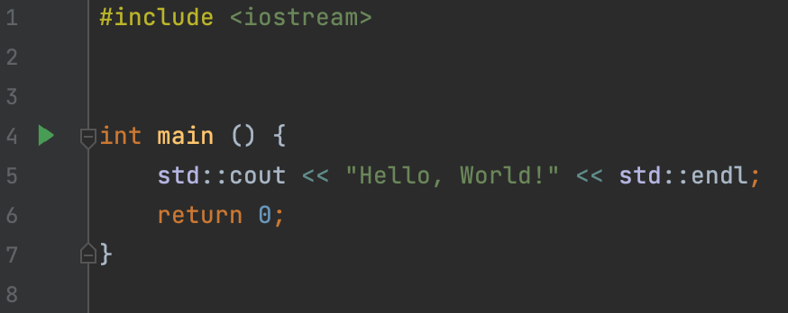
Program structure
A program is a sequence of instructions
A C++ program must have a main function.
Before the program code, you can specify header files. Example: #include <iostream>
Function body "is a sequence of instructions separated by a symbol ;
Usually, instructions are of three types: declaration, expression, control structure

Slide 3
Declarations
A declaration is a statement in two or three parts:
type identifier [= value or literal];
With a declaration, you can create a variable:
int x = 3;
Type:
In C ++, the type system is strict. This means that every variable in your code has one well-defined type. In Python, for example, this is not the case.
During the execution of your program, in the areas of RAM allocated for storing your local variables a new space of size corresponding to the size of the type of your variable is allocated in result of the declaration instruction.
Each type has a numeric value called the size of the type, which indicates how much space variables of this type take up in RAM.

Slide 4
Fundamental types
C ++ has a specific set of built-in types:
Integer variables: store only integer (possibly negative) values
Real variables: store an arbitrary real number
Boolean variables: store one of two possible values: true or false.
Character variables: store an arbitrary character from an ASCII table (will discuss that later)
int Size: 4 bytes. Stores integers in the range [-2 ^ 31, 2 ^ 31 - 1]
unsigned Size: 4 bytes. Stores positive integers in the range [0, 2 ^ 32 - 1]
long long Size: 8 bytes. Stores integers in the range [-2 ^ 63, 2 ^ 63 - 1]
unsigned long long Size: 8 bytes. Stores positive integers in the range [0, 2 ^ 64 - 1]
float Size: 4 bytes. Stores an approximate value of a real number
double Size: 8 bytes. Stores an approximate value of the a number with double precision
long double Size: 16 bytes. Stores an approximate value of the a number with 4x precision
bool Size: 1 byte. Stores a Boolean value: true or false
char Size: 1 byte. Stores a character from ASCII table

Slide 5
Identifiers
Any sequence of Latin letters, numbers and underscores that does not begin with a number and is not a keyword can be used as an identifier.
Example:
a_simple_identifier
x_dir1
Keywords:
if
else
for
do
while
switch
class
…
NON-Keywords:
vector
map
cout
cin
endl
list
array
…

Slide 6
Literals
A literal is a typed special value that can be used to initialize a variable.
most primitive types have literals of their own.
Examples:
1 int
’a’ char
true bool
false bool
“abc” string literal (will discuss later)
0.2f float literal
0.3 double literal
nullptr pointer literal (will discuss later)

Slide 7
Variable definitions with literals
Examples: int x = 5; bool y = true; float z = 5.1f; double k = 5.0; long long p = 5ll;
Implicit type conversions
if you try to initialize a variable of a certain type with a certain literal of another type, in some cases it will work (and in some it will be an error).
Examples:
int x = 5.8;
bool y = 1;
float z = 5.1;
double k = 5;

Slide 8
Other examples of implicit conversions
bool <–> int implicit conversions:
bool –> int:
false –> 0
true –> 1
int –> bool:
0 –> false
Every other number –> true
Rule: when converting between types of different sizes, it is important to follow the rule: a number that can be converted to a specific type should not exceed the range of values ​​of this type. Otherwise, a certain complex and ambiguous situation will occur, which is called overflow.
Some more examples of implicit type conversions:
‘a’ + ‘b’ –> int char –> int
5/3 –> int division operator (will be discussed later) results in integer
long long x = 5 int –> long long

Slide 9
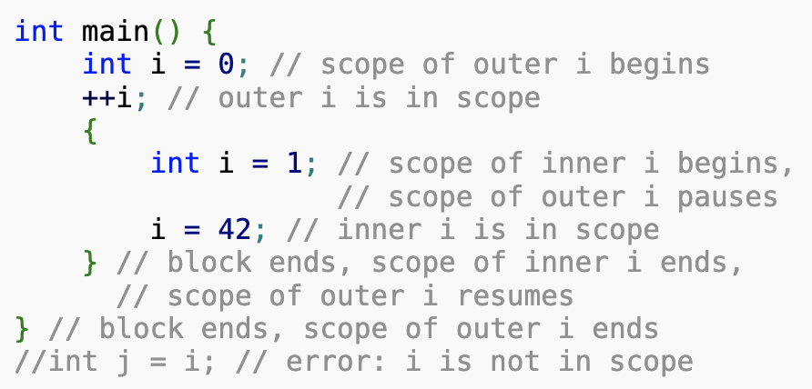
Scopes
Each name that appears in a C++ program is only visible in some possibly discontiguous portion of the source code called its scope.
Within a scope, unqualified name lookup can be used to associate the name with its declaration.
There are different kinds of scopes: block scope, function arguments scope, namespace scope, enumeration scope, class scope, etc. But today we will only talk about one of them: block scope.
Block scope
The potential scope of a name declared in a block (compound statement) begins at the point of declaration and ends at the end of the block. Actual scope is the same as potential scope unless an identical name is declared in a nested block, in which case the potential scope of the name in the nested block is excluded from the actual scope of the name in the enclosing block.

Slide 10
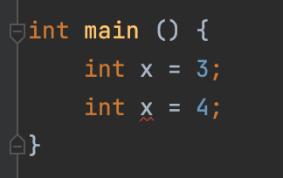
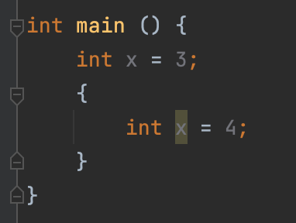
Scopes
One definition rule:
A variable with a certain identifier can only be defined once in a scope.
Error:
BUT this code is ok:

